Slide 1
Why do people create?
Chapter 1.2

Slide 2
Bellringer-august 16
Name some different categories that identify why people make art. Can there be more than one reason?

Slide 3
Utility
Items that served a purpose p. 8
This basket was used to store items in, however, the artist went above and beyond by adding the detailed design and most likely took twice as long to create it.
This helps to support the evidence that some artworks serve two purposes.
What are some items in your homes/everyday lives that serve more than one purpose?

Slide 4
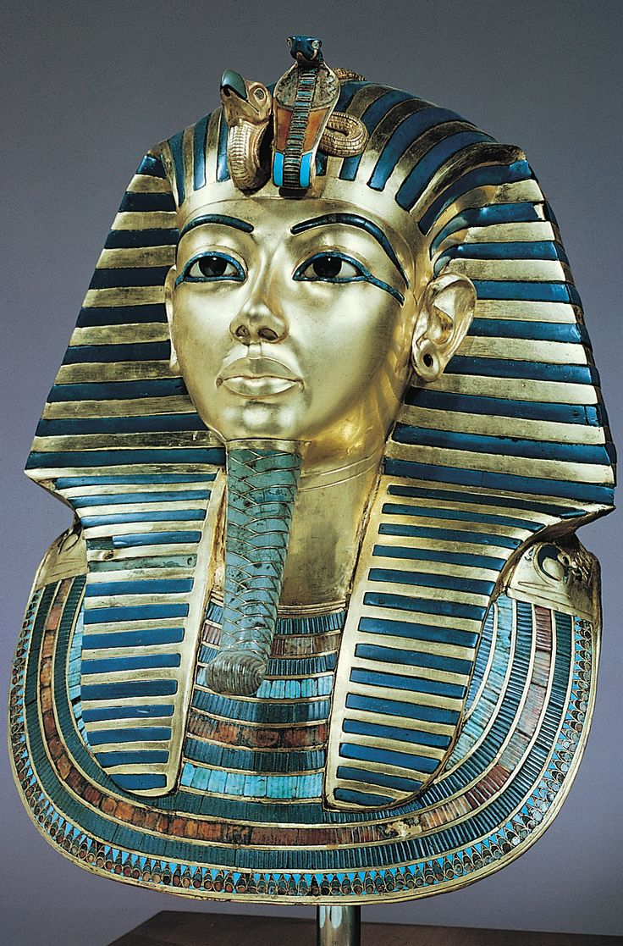
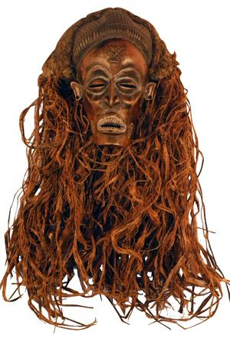
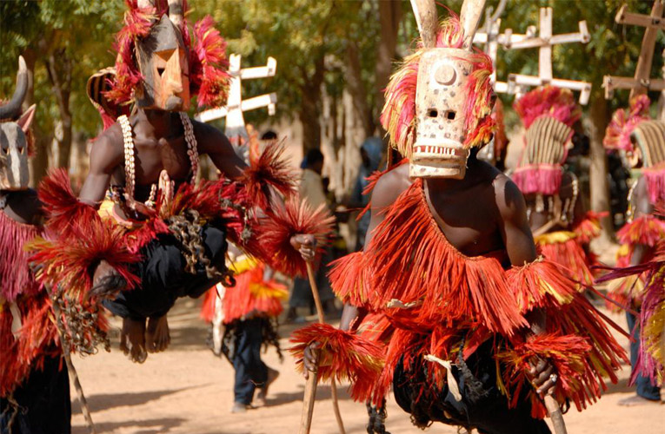
Religion
Many historical art pieces serve the purpose of supporting religious activities and beliefs.
Ancient Egypt mask
Ancient Mali masks
African spirits mask

Slide 5
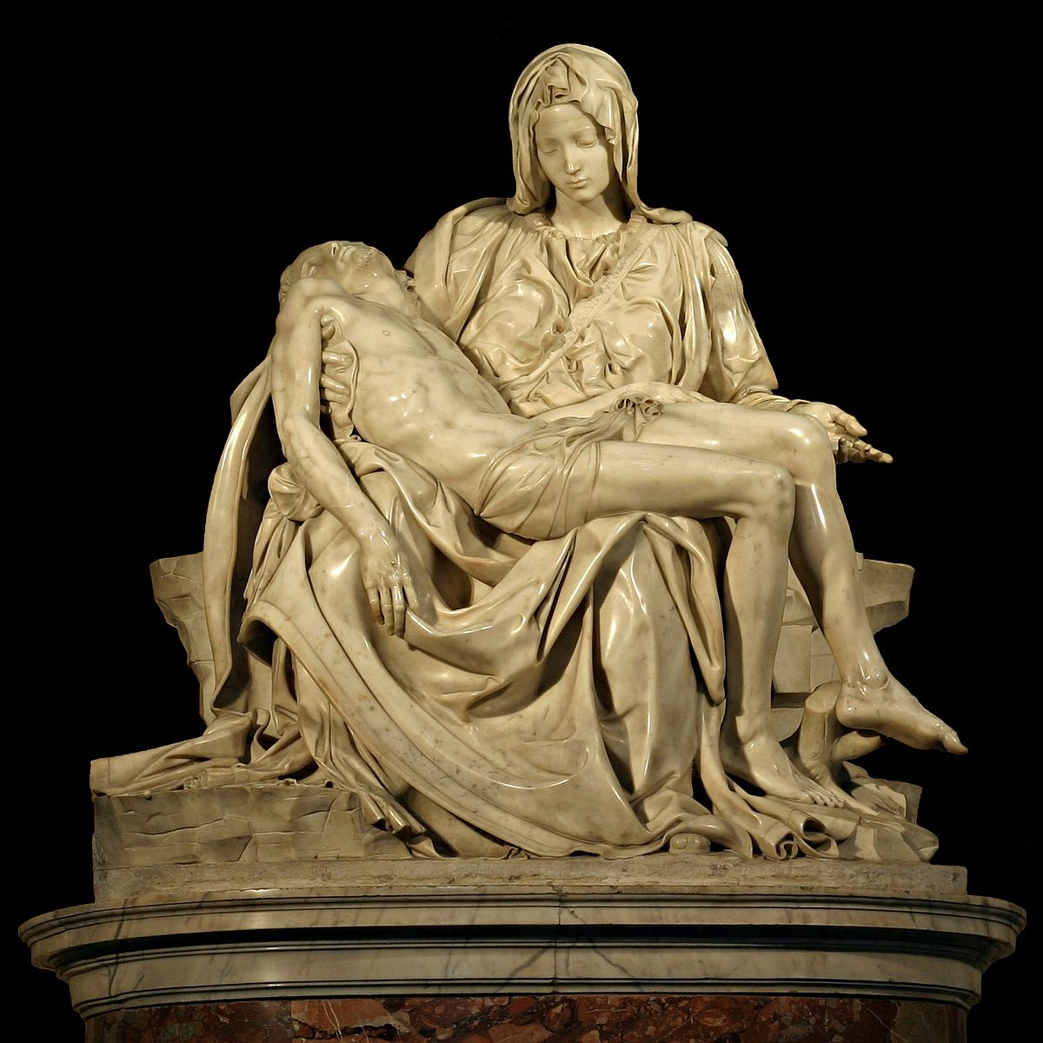
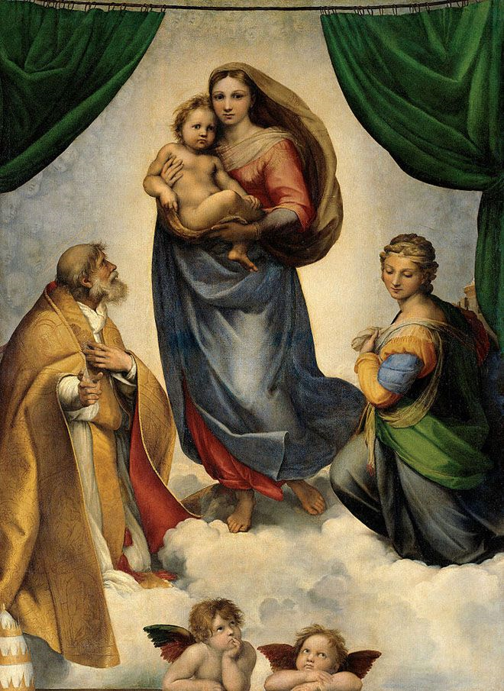
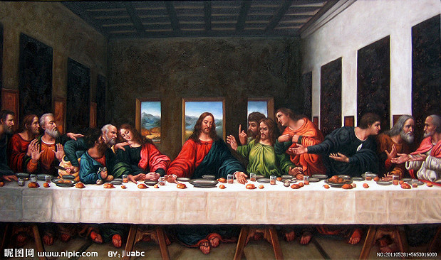
Religion
Michelangelo
Da Vinci
Raphael

Slide 6
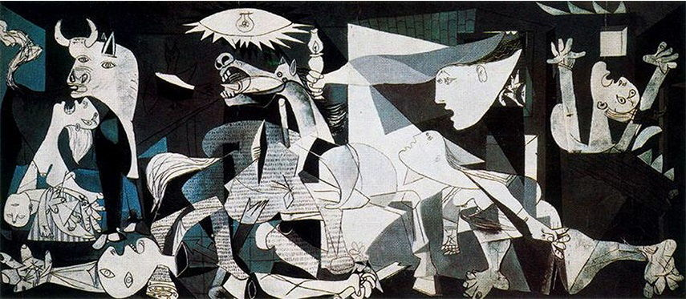
Politics
The political side of art has changed vastly since the beginning of art history.

Slide 7
Information/history
In many cultures, art was used to teach. The use of art helped with those who had language barriers. Artworks have also been used to pass down history.
Art at this time was used to document history and record it for future use, because there was no other method of doing this.

Slide 8
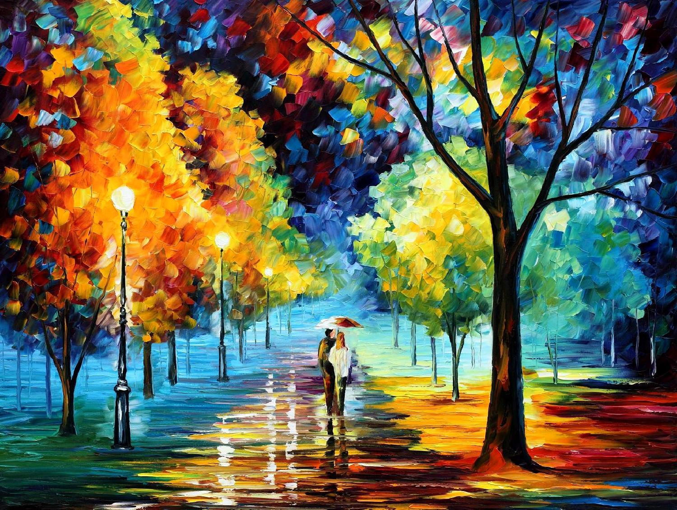
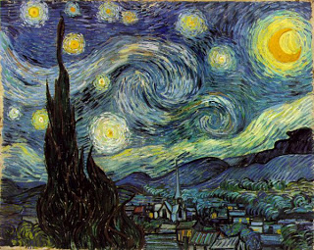
aesthetics
Aesthetic is a term meaning beauty. This artwork could be best described as decoration or art we have for fun.

